Slide 1



KS3 Mathematics
S3 Plans and Elevations
Notes:
The aim of this unit is to teach pupils to:
Use 2-D representations, including plans and elevations, to visualise 3-D shapes and deduce some of their properties
Material in this unit is linked to the Key Stage 3 Framework supplement of examples pp 198-201.

Slide 2


Shape sorter
A solid is made from cubes. By turning the shape it can be posted through each of these three holes:
Can you describe what this shape will look like?
Can you build this shape using interlocking cubes?
Notes:
Provide pupils with interlocking cubes and ask them to make a shape that could be rotated to fit through all three holes. Is there more than one possibility?

Slide 3
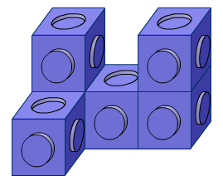
Shape sorter
A solid is made from cubes. By turning the shape it can posted through each of these three holes:
Here is a picture of the shape that will fit:
Notes:
Here is one possibility; a few variations are possible (by moving the cube at bottom left).

Slide 4
Plans and elevations
A solid can be drawn from various view points:
Plan view
2 cm
7 cm
2 cm
3 cm
Side elevation
Front elevation
7 cm
3 cm
3 cm
2 cm
7 cm
Notes:
Define the plan view as the view of a solid from directly above. In this example the plan view is a 2 cm by 7 cm rectangle.
Define the front elevation as the view of the solid from directly in front. In this example the front elevation is a 3 cm by 7 cm rectangle.
Define the side elevation as the view of the solid from the side. In this example the side elevation is a 3 cm by 2 cm rectangle.

Slide 5
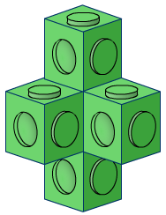
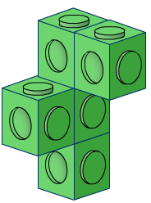
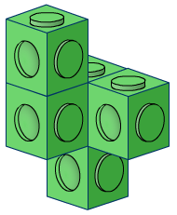
Choose the shape
Front elevation:
Side elevation:
Plan view:
A:
A:
B:
C:
Notes:
Ask pupils to choose the shape that corresponds to the three views given.

Slide 6
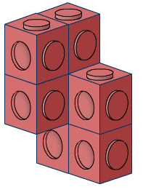
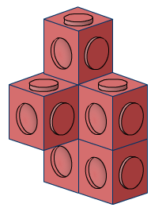
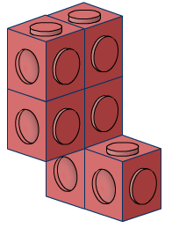
Choose the shape
Front elevation:
Side elevation:
Plan view:
A:
B:
C:
C:
Notes:
Ask pupils to choose the shape that corresponds to the three views given.

Slide 7
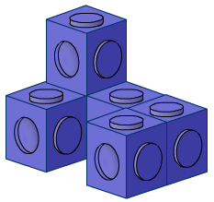
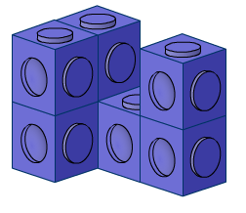
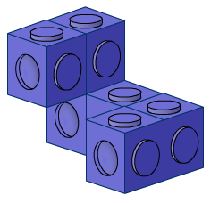
Choose the shape
Front elevation:
Side elevation:
Plan view:
A:
A:
B:
C:
Notes:
Ask pupils to choose the shape that corresponds to the three views given.

Slide 8
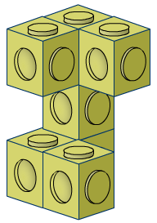
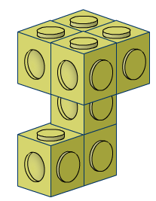
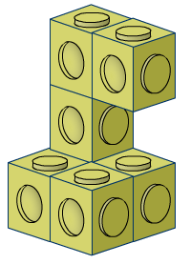
Choose the shape
Front elevation:
Side elevation:
Plan view:
A:
B:
B:
C:
Notes:
Ask pupils to choose the shape that corresponds to the three views given.

Slide 9
Plans
Sometimes the plan of a solid made from cubes has numbers on each square to tell us the number of cubes on that base.
For example, this plan:
2
2
1
1
represents this solid:

Slide 10
Shadows
What solid shape could produce this shadow?
Notes:
The obvious answer is a cuboid, although any prism could be orientated to produce this shadow. We could also have a pyramid with a rectangular base.

Slide 11
Shadows
What solid shape could produce this shadow?
Notes:
Possible answers include a tetrahedron, any pyramid (including a cone) or a triangular prism.

Slide 12
Shadows
What solid shape could produce this shadow?
Notes:
Possible answers include a sphere, a cylinder or a cone.

Slide 13
Shadows
What solid shape could produce this shadow?
Notes:
Possible answers include a cube, a cuboid with a square cross-section, a square-based pyramid or any prism whose length is equal to its height.

